Slide 1
LENDING CLUB CASE STUDY
By Atul Srivastava &
Srilekha Amancheerla

Slide 2
Agenda
Problem statement and approach
Analysis – Univariate & Bivariate
Conclusion & Recommendation

Slide 3

PROBLEM STATEMENT
Lending club case study:
Lending club specialized in the various types of loans offering to urban customers would like to assess the risk of loan defaulters in order to minimize credit losses to the company

Slide 4

APPROACH​
Data cleaning
Dropped the columns with single unique value – 9 columns
Dropped the columns which has only null values – 54 columns
Understanding the data dictionary, unuseful columns for analysis is dropped – 17 columns
Data cleaning is performed on total of 111 coulmns to arrive at the required column count for further analysis on 31 columns.
Outliers for Annual income column, term columns, loan amount, funded amount and interest rate are removed

Slide 5
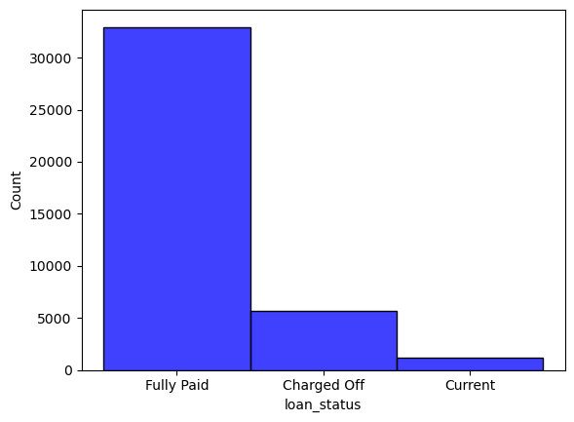
APPROACH​
Data Analysis - Univariate
Analysis on loan status
14.17% loans are charged off.
2.87 % loans are still running therefore those loan will not be participating in analysis

Slide 6
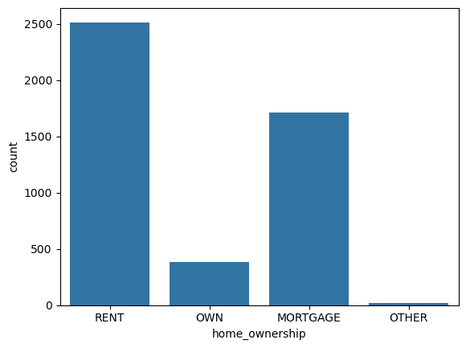
APPROACH​
Data Analysis - Univariate
Analysis on Home ownership
Inference - most of the customers are living rented place.

Slide 7
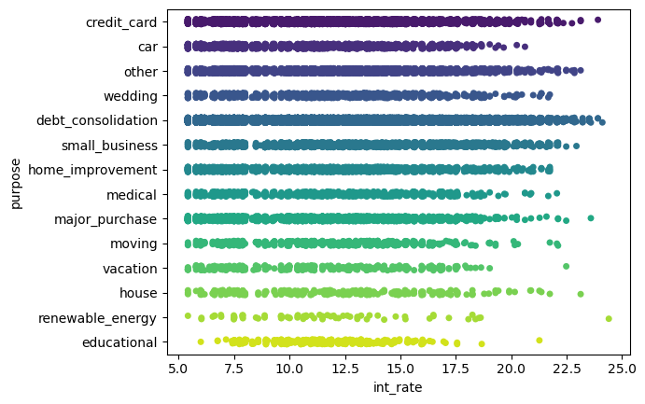
APPROACH​
Data Analysis - Bivariate
Analysis on Purpose and Int rate
Inference - most of the lending is on debt consolidation and the credit cards are highly likely to be charged-off

Slide 8
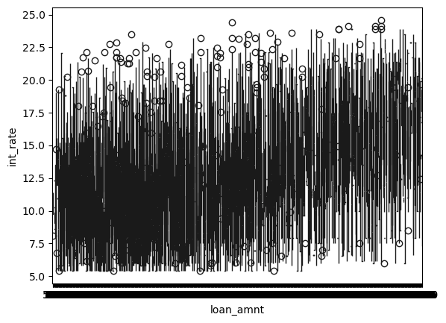
APPROACH​
Data Analysis - Bivariate
Analysis on Loan amount and Int rate
Inference - most of the borrowers are on the interest range 7.5% to 15%

Slide 9
CONCLUSION
Borrowers with high interest and 10+ years of employment length.
Borrowers living on mortgage with loan amount greater than 12000.
Loan for debt consolidation, credit card, small business with loan amount greater than 12000. For any loan amount provided with an average interest rate higher than 13%.
Loan provided for house purpose with average interest grater than 15%.
Installments between 800 - 12000 with average interest greater than 15%.
Average interest rate of 17% with installment greater than 12000.

Slide 10
Recommendation
Limit the loan amount to 12000 for applicants with ownership of mortgage. This also show financial status of a risky applicant.
To encourage small business but also keep the investors less risked. The rate of interest for applicants for small business can be reduced around 2%
Increase the rate of interest by 0.5% to the loan amount for applicants whose purpose is moving, as the loan amount is less and are more likely to repay.

Slide 11
THANK YOU
Brita Tamm​
502-555-0152​
brita@firstupconsultants.com​
www.firstupconsultants.com

